Slide 1
The battle of neighbourhoods
Peer graded Assignment/Applied data Science Capstone (week 4/5)

Slide 2
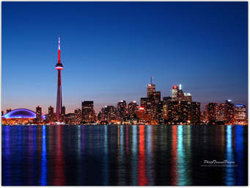
VEGetarian/vega restaurant CASE
BUSINESS CASE
Company A intends to open a new Vegetarian restaurant
Limited resources available
Company has adopted principle of Data Driven Decision Making
Focus is on city Toronto
Agressive Strategy: focus on American restaurant/locate near American Restaurants, driven by changed customer preferences (more and more healthly food instead of meat, high calorie/high fat)

Slide 3
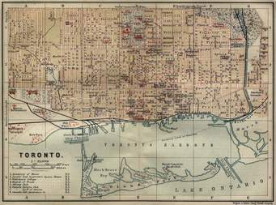
VEGetarian/vega restaurant CASE
DATA ACQUISITION
Toronto Neighbourhood Data (Wiki)
Geospatial Data -Latitude/Longitude (Geospatial package or .csv)
Venue data of Toronto districts (Foursquare API)

Slide 4
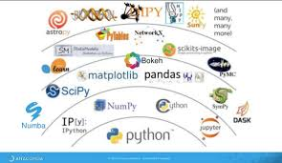
VEGetarian/vega restaurant CASE
PYTHON PACKAGES
Pandas
NumPy
Requests
Json
Matplotlib
Folium
Sklearn

Slide 5
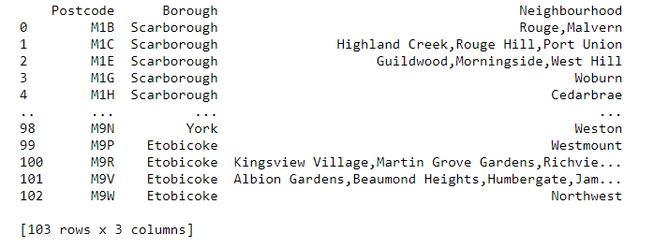
VEGetarian/vega restaurant CASE
DATA EXPLORATION, TRANSFORMATION AND CLEANING (1 OF 3: Toronto Neighbourhood Data)
Transformation to Pandas DataFrame format
Removing null (“not assigned”) values
Removing duplicates

Slide 6
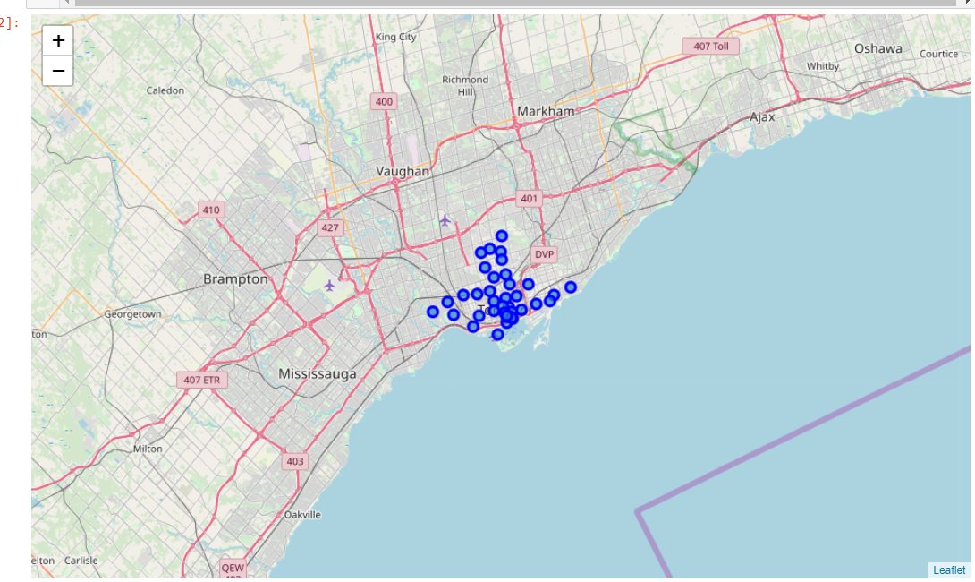
VEGetarian/vega restaurant CASE
DATA EXPLORATION, TRANSFORMATION AND CLEANING (2 OF 3: Geospatia Data)
Transformation to Pandas DataFrame format
No other cleaning activities necessary
Merged with Toronto Neighboorhood data-> adding lat/log to Neighbourhood
Due to limitations of the Foursquare sandbox account: Filter on Boroughs with “Toronto” in the name i.e.
West Toronto, East Toronto, Downtown Toronto and Central Toronto
Display using Folium map

Slide 7
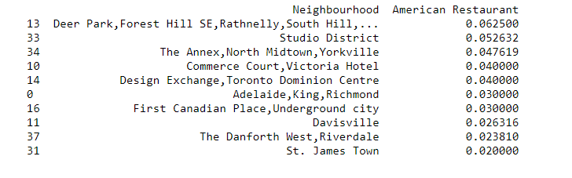
VEGetarian/vega restaurant CASE
DATA EXPLORATION, TRANSFORMATION AND CLEANING (3 OF 3: Foursquare venue data)
Obtaining of venues data within 500 meter of the neighbourhood locations (lat, lon) via Foursquare API/Foursquare sandbox account
Transformation to Pandas DataFrame format
Filtering DataFrame1 to only include Venue Category which reflect Restaurants
One-hot-encoding to transform Venue Categories (All Venue Categories) to separate columns (DataFrame 2) . Calculate the relative frequency per Vendor Category within each Neighbourhood.
From DataFrame 2 (one-hot-encoded) obtain the “Neighbourhood” and relative frequency of American Restaurants only as input data for the Clustering algorithm. Sort in descending order by relative frequency.

Slide 8
VEGetarian/vega restaurant CASE
SELECTION TYPE OF MACHINE LEARNING
Input
Requirements reflected in business case
Exploratory character to support decision making process
No labelled data available which eliminates the use of Supervised methods
Selection
Clustering algorithm (K-means using 4 clusters) to cluster the Toronto neighbourhoods
For input dataset see below

Slide 9
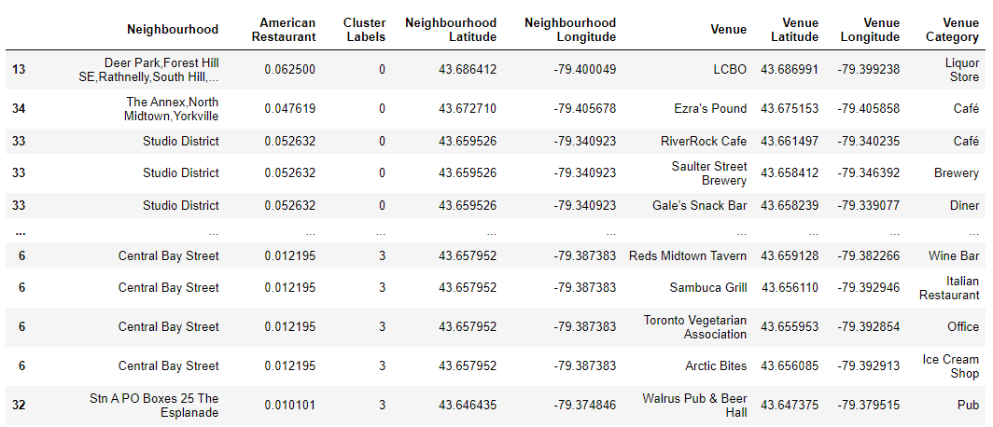
VEGetarian/vega restaurant CASE
NEXT STEPS
Add the cluster labels and the relative frequency of the American Restaurants to DataFrame 1 Requirements reflected in business case
…

Slide 10
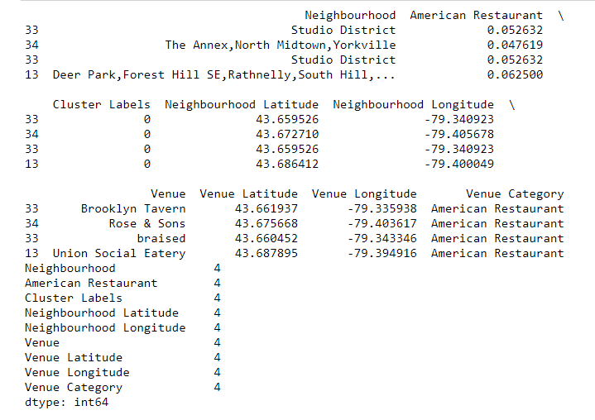
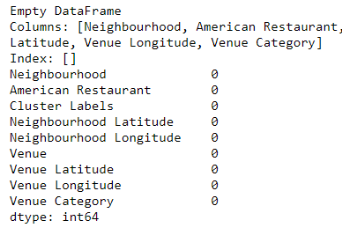
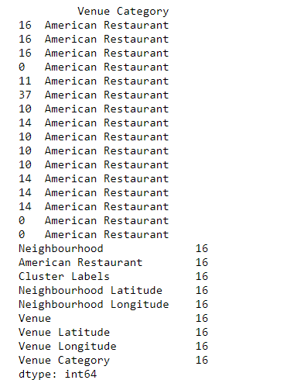
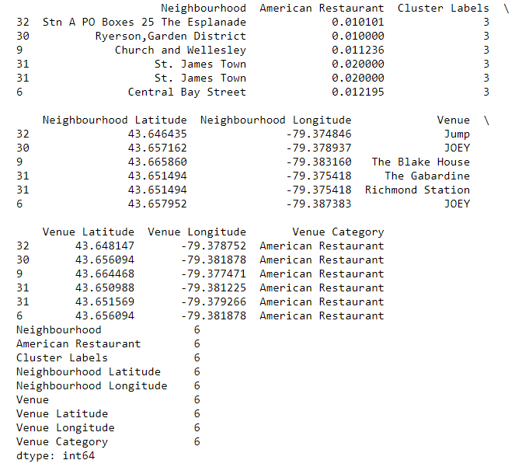
VEGetarian/vega restaurant CASE
NEXT STEPS
Explore the 4 clusters(see below);
Cluster 2 is superior regarding the total number of American Restaurants (16 of 26 in total)
Cluster 0: 4 Am Restaurants Cluster 1: 0 Am Restaurants Cluster 2: 16 Am Restaurants Cluster 3: 6 Am Restaurants

Slide 11
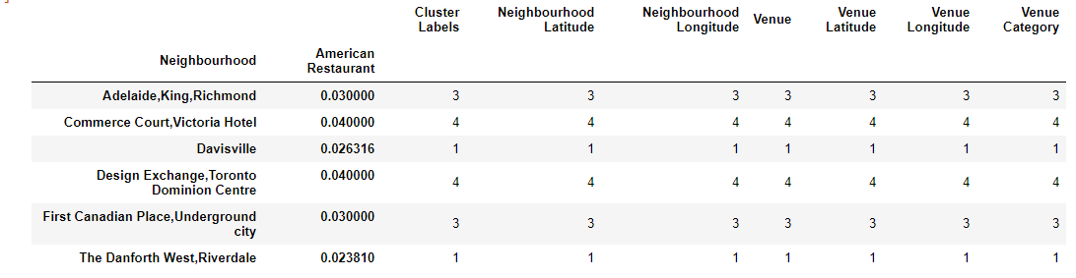
VEGetarian/vega restaurant CASE
NEXT STEPS -> FURTHER EXPLORATION AND CONCLUSION
The selection of cluster 2 as superior cluster is not sufficient to answer the business case (As it contains multiple neighbourhoods, we want however 1 location only).
Further breakdown of cluster 2 necessary reflecting the number of American restaurants per neighbourhood within this cluster
CONCLUSION
Neighbourhoods “Commerce Court, Victoria Hotel” and “Design Exchange, Toronto Dominion Centre” contain the most American Restaurants within Cluster 2 (both 4). In absence of further information/data to further prioritize the recommendation is to select either one of these neighbourhoods for the opening of the new Vegetarian/Vega restaurant.

Slide 12
VEGetarian/vega restaurant CASE
FURTHER NEXT STEPS/DISCUSSION
Case simplified, does not reflect a real world scenario (as has to fit within the context/timeframe of the course and should take into account the limitations of the Foursquare sandbox account)
Real World Scenario contains more features/factors underlying the business decisions. Examples are real estate prices, number of residents per neighbourhoods, additional demogrpahics like average age, income, restaurant turnovers and additional location features.

